Slide 1
Information Travel and Pandemics
Working Group III: Lisa Beckmann, Mela Eckenfels, Nathanael Gutknecht und Zuzanna Mielczarek

Slide 2
Agenda
Introduction
Research Question
The Model
Results
Limitations
Summary and Outlook

Slide 3
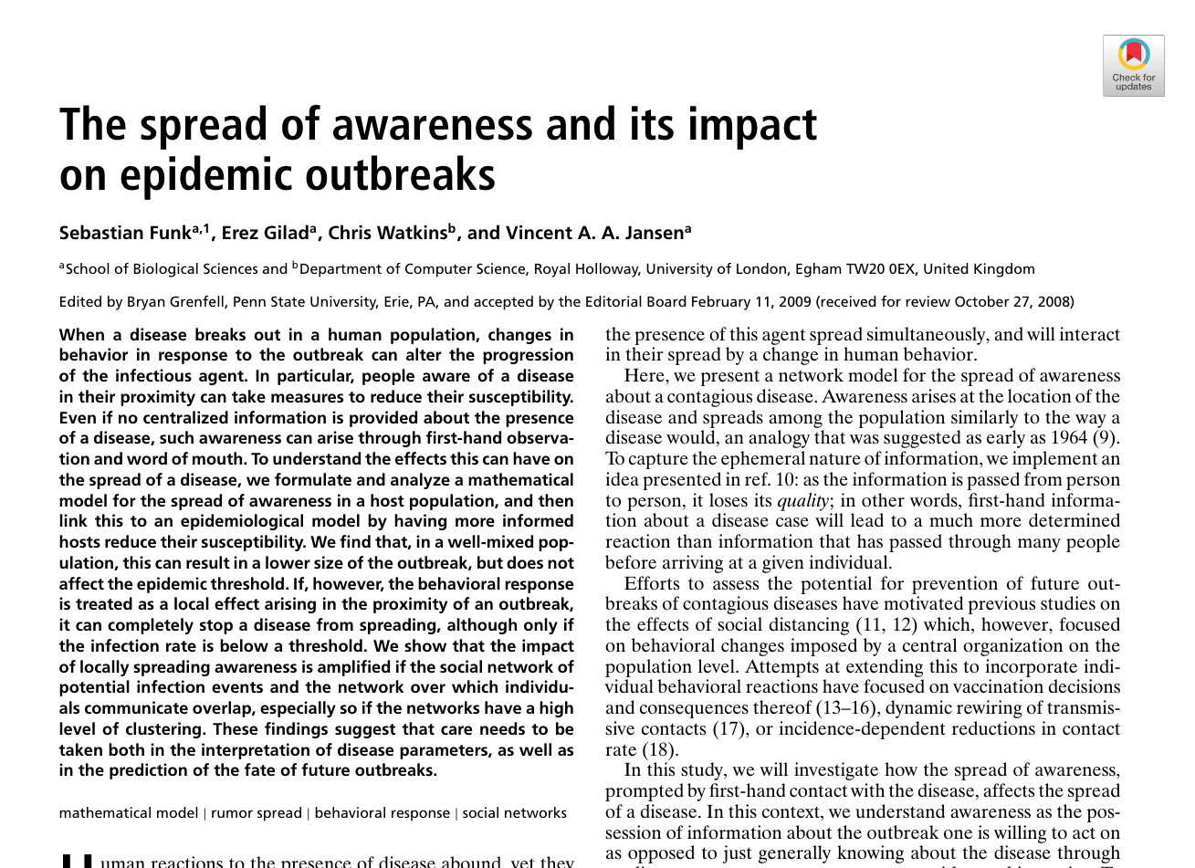
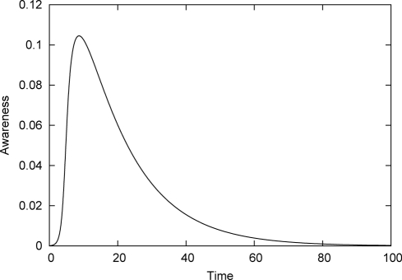
Introduction
Paper of choice:
Funk et al (2009): The spread of awareness and its impact on epidemic outbreaks
Two aspects of epidemic spread: information and illness
Research: Influence of awareness on epidemic spreading
Fig. 1. Awareness g(ρ,t) in the well-mixed population as a function of time for a given ρ < 1 if information is not replenished by the presence of the disease.
Introduction Research Question The Model Results Limitations Summary and Outlook

Slide 4
Research Question
1. Which conditions can help to contain outbreaks through information spreading?
2. What is the impact of self-isolation of knowingly infected individuals on the spread of a disease and under which conditions is it most impactful?
Introduction Research Question The Model Results Limitations Summary and Outlook

Slide 5
The Model
Implementing SIR-Model for disease as a (30x30) grid with four neighbours for each person
each individual is associated to the states of SIR with probabilities
Including Awareness into the Model
People with a high rates of awareness are less likely to get infected
Information wanes with time and number of passages
Information is generated by infected individuals
Introduction Research Question The Model Results Limitations Summary and Outlook
Notes:
weitere Aspekte gerne rein und Bilder

Slide 6
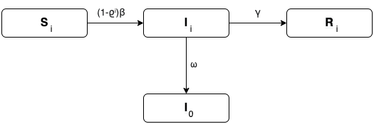
The Model
Legend:
β: normal infection rate
ϱ: decay rate
γ: Recovery rate
ω: Information generation rate
i: awareness (0 is highest)
Fig.2 Flowchart of the SIR model. The boxes describe individuals having one of three possible conditions: being susceptible, infected or recovered. The arrows show the transition rates.
Introduction Research Question The Model Results Limitations Summary and Outlook

Slide 7
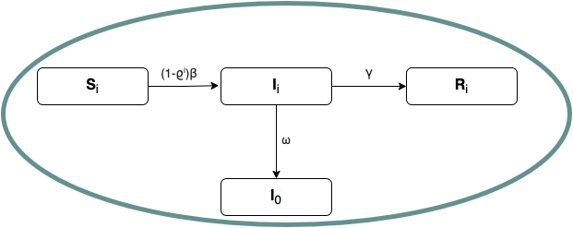
The Model
Legend:
β: normal infection rate
ϱ: decay rate
γ: Recovery rate
ω: Information generation rate
i: awareness (0 is highest)
Fig.2 Flowchart of the SIR model. The boxes describe individuals having one of three possible conditions: being susceptible, infected or recovered. The arrows show the transition rates.
Introduction Research Question The Model Results Limitations Summary and Outlook

Slide 8
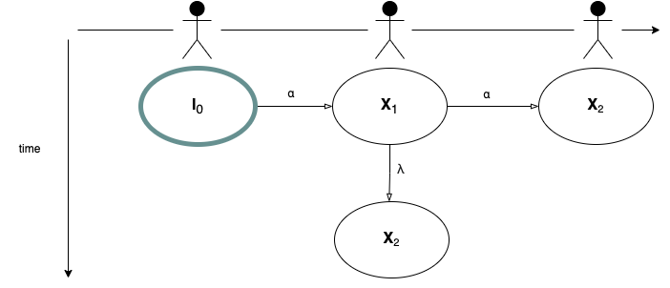
The Model
Legend:
β: normal infection rate
ϱ: decay rate
γ: Recovery rate
ω: Information generation rate
i: awareness (0 is highest)
α: Information transmission rate
λ: Information fading rate
Fig.2 Flowchart of the SIR model. The boxes describe individuals having one of three possible conditions: being susceptible, infected or recovered. The arrows show the transition rates.
Fig.3 Flowchart of the awareness generation. The boxes describe the individuals and the arrows describe the information transmission/fading with time. The index describes the grade of awareness.
Introduction Research Question The Model Results Limitations Summary and Outlook

Slide 9
The Model
Basic Model
only susceptible individuals act based on information received from neighbors
Extension
Self-isolation of knowingly infected individuals with a probability κ
+ also the infected individuals (acting on information generated by themselves)
Introduction Research Question The Model Results Limitations Summary and Outlook
Notes:
weitere Aspekte gerne rein und Bilder

Slide 10
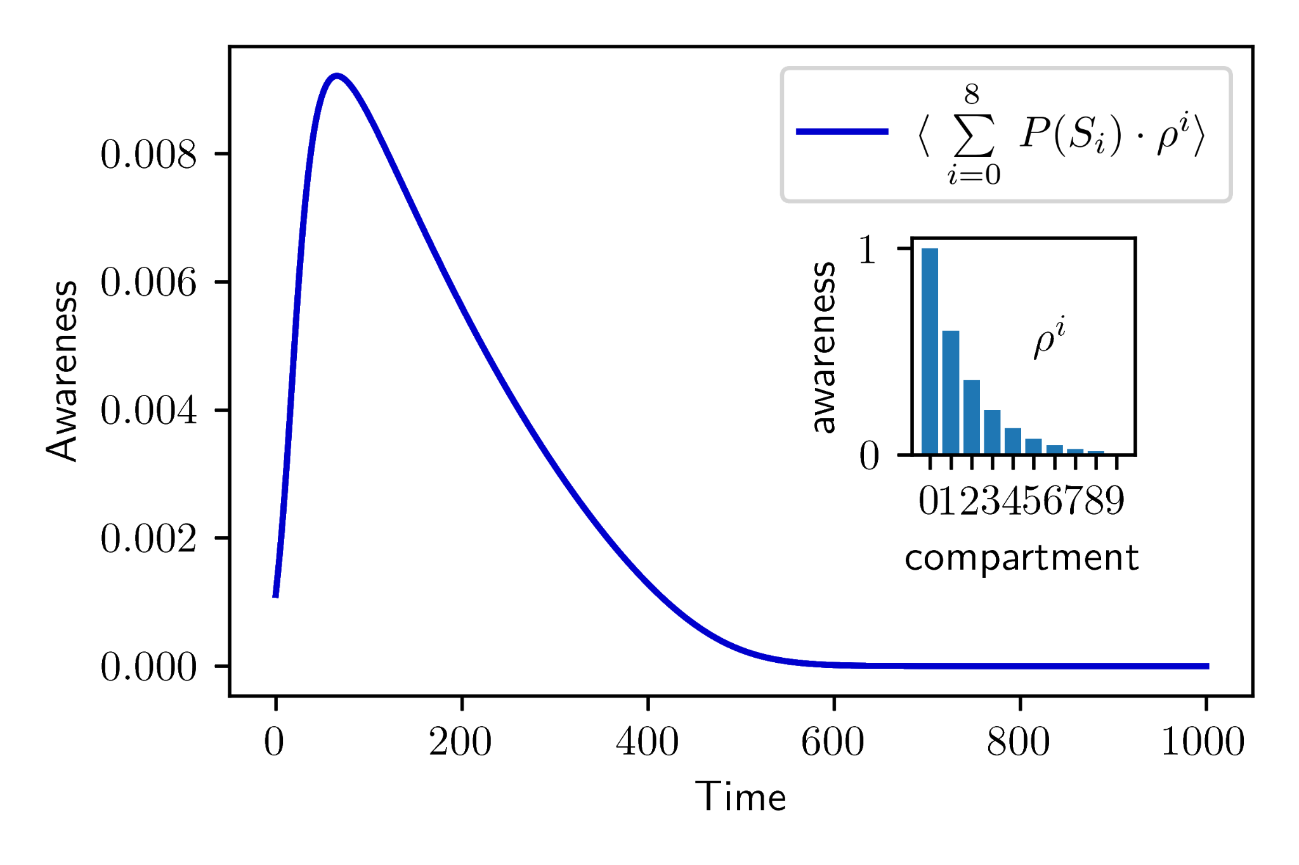
Awareness without Infections
Fig. 4. Comparison between the awareness level g(ρ,t) in the population when no infections are present to generate new awareness. Left: original figure from Funk et al (2009) for a well-mixed population (mean field analysis); Right: own recreation on a square lattice with interactions between nearest neighbors only.
Introduction Research Question The Model Results Limitations Summary and Outlook
Notes:
Besser?

Slide 11
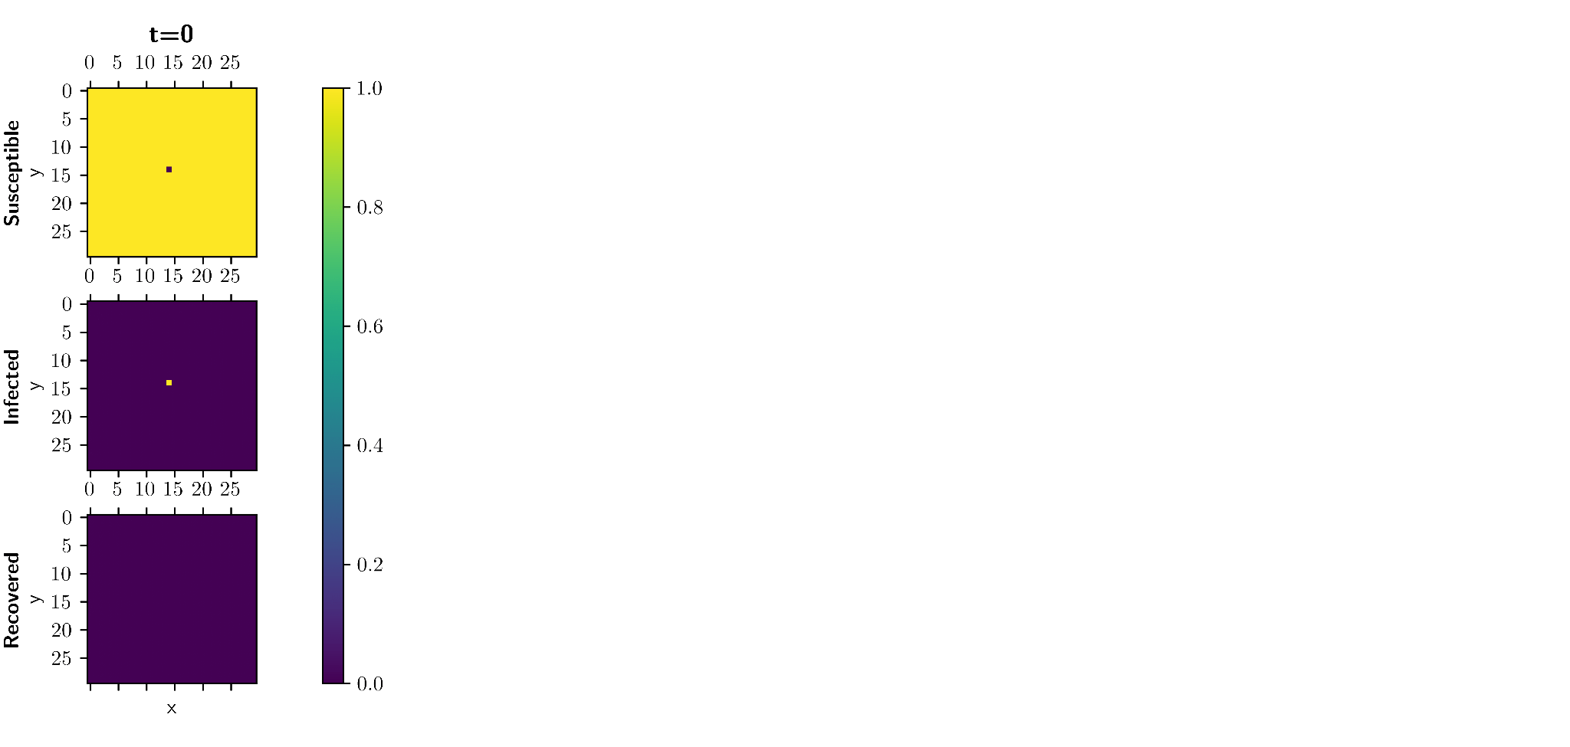
Introduction Research Question The Model Results Limitations Summary and Outlook
Notes:
Awareness plot

Slide 12
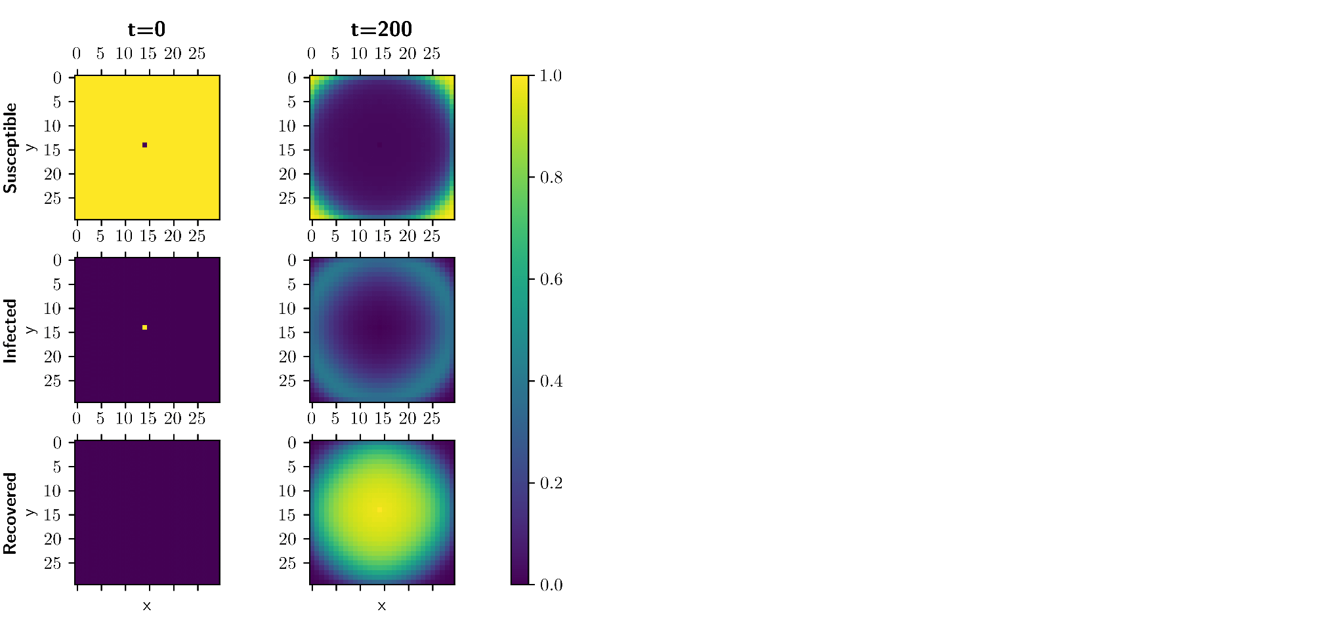
Introduction Research Question The Model Results Limitations Summary and Outlook
Notes:
Awareness plot

Slide 13
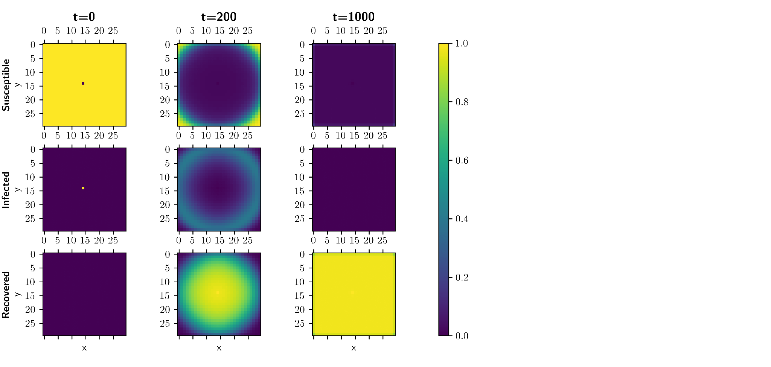
Introduction Research Question The Model Results Limitations Summary and Outlook
Notes:
Awareness plot

Slide 14
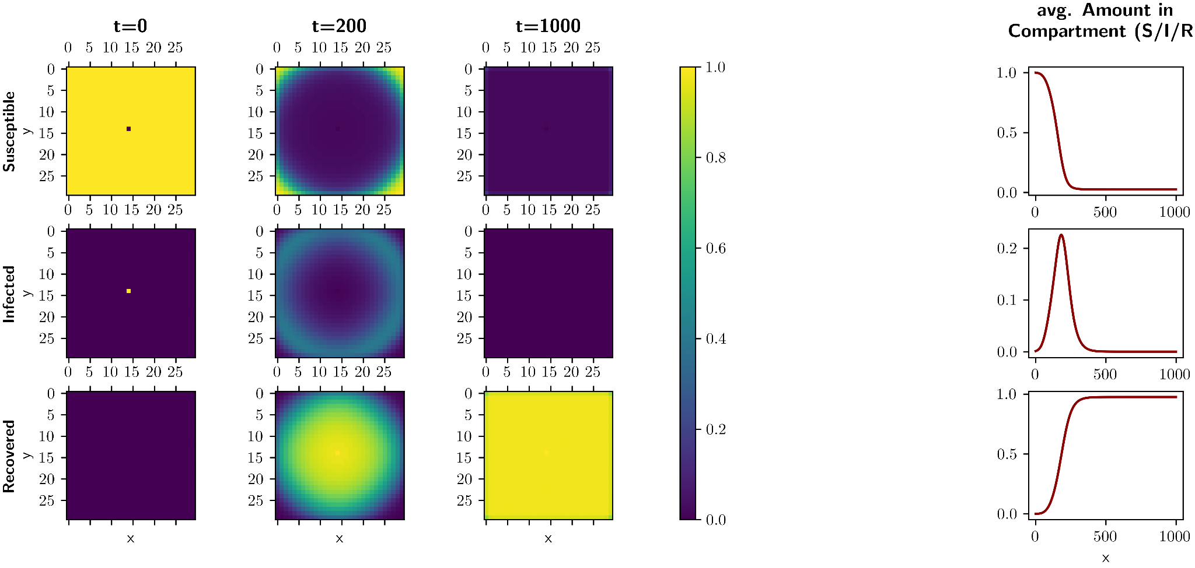
Fig. 5 spread of infections based on an SIR model without awareness
Introduction Research Question The Model Results Limitations Summary and Outlook
Notes:
Vielleicht so? der Abstand ist nicht so groß jetzt

Slide 15

Introduction Research Question The Model Results Limitations Summary and Outlook
Notes:
Awareness plot

Slide 16
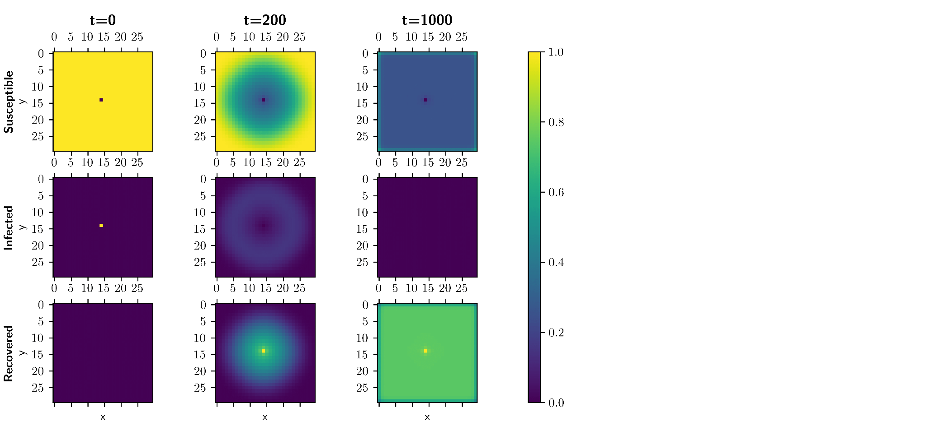
Introduction Research Question The Model Results Limitations Summary and Outlook
Notes:
Awareness plot

Slide 17
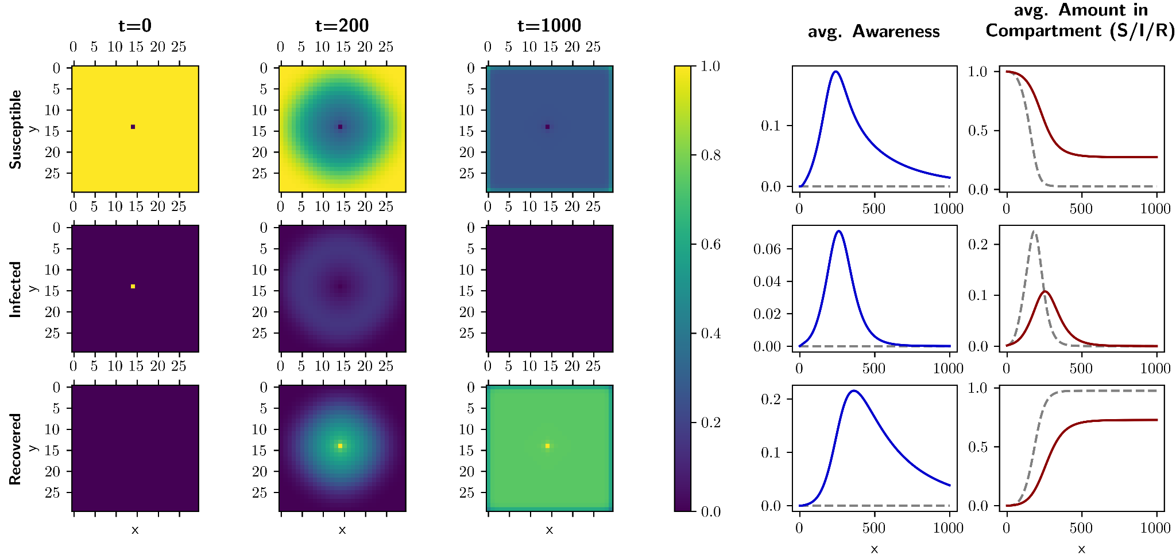
Fig. 6 Spread of infections on a rectangular lattice based on an SIR model with awareness, which causes people to reduce their susceptibility. Left: Spatial distribution of infections on the grid at the beginning, during and after the outbreak. Right: The spread is reduced both in speed and intensity compared to the case without awareness (gray line, dashed).
Introduction Research Question The Model Results Limitations Summary and Outlook
Notes:
Awareness plot

Slide 18
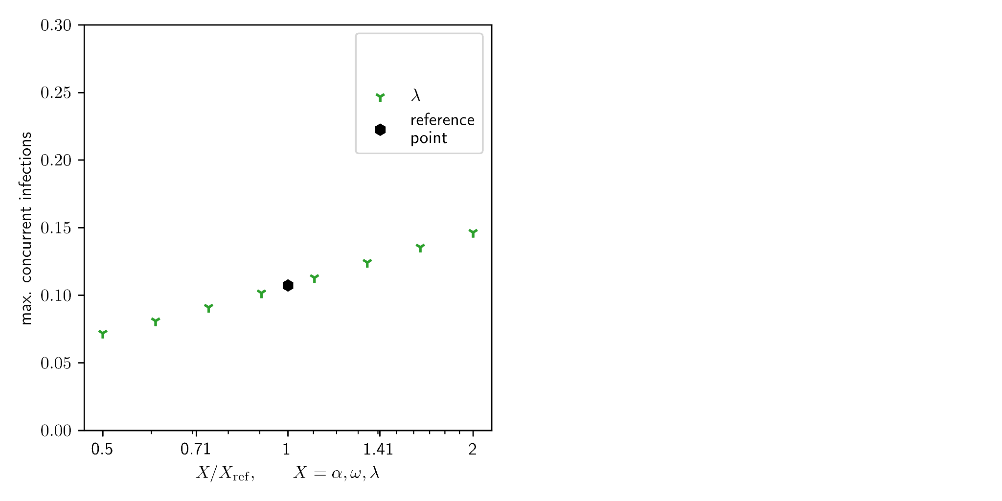
Legend:
λ: Information fading rate
Introduction Research Question The Model Results Limitations Summary and Outlook
Notes:
Awareness plot

Slide 19
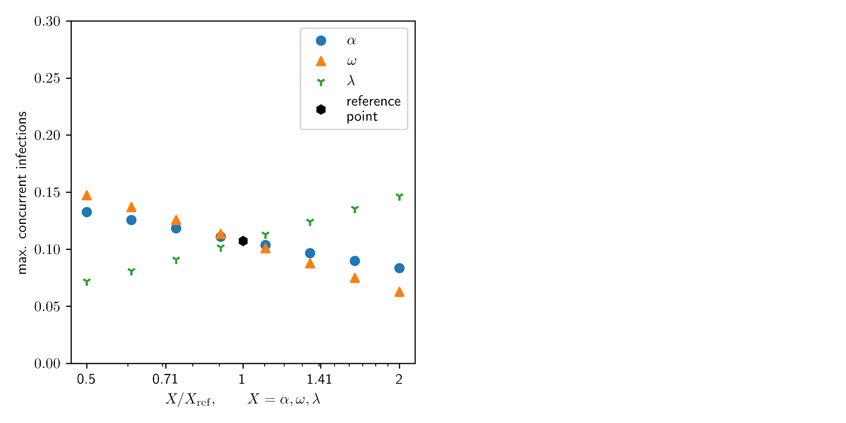
Legend:
α: Information transmission rate
ω: Information generation rate
λ: Information fading rate
Introduction Research Question The Model Results Limitations Summary and Outlook
Notes:
Awareness plot

Slide 20
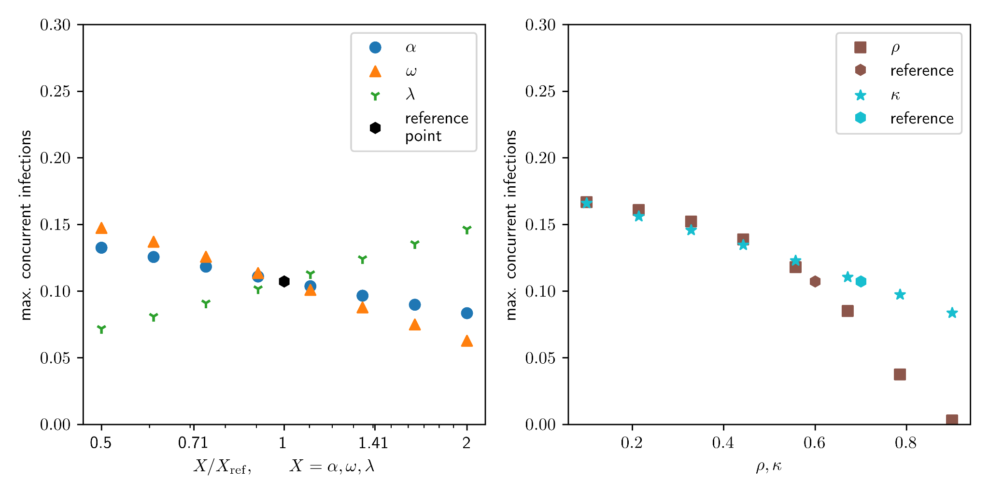
Legend:
α: Information transmission rate
ω: Information generation rate
λ: Information fading rate
Legend:
ϱ: decay rate
κ: isolation rate
Reference Parameters:
β: 0.03 normal infection rate
γ: 0.03 Recovery rate
ω: 0.06 Information generation rate
α: 0.06 Information transmission rate
λ: 0.05 Information fading rate
ϱ: 0.6 decay rate for information quality
κ: 0.7 self isolation probability
Fig. 7 Sensitivity analysis for rates and parameters related to creation and decay and impact of awareness.
Introduction Research Question The Model Results Limitations Summary and Outlook
Notes:
Awareness plot

Slide 21
Main Results
1. Which conditions can help to contain outbreaks through information spreading?
Big impact: High ϱ (decay rate) can “freeze” the outbreak → if awareness stays long
2. What is the impact of self-isolation of knowingly infected individuals on the spread of a disease and under which conditions is it most impactful?
Self-isolation will help limit the spread of the disease, yet it is harder to discern the ideal condition.
Introduction Research Question The Model Results Limitations Summary and Outlook
Notes:
Superduperendslide mit dem alle glücklich sind. :D
Yay

Slide 22
Limitations
Time constraints led to
… a very basic model
… a non-realistic contact pattern
… the lack of complex approaches.
… a limited population size
… the percentual approach does not allow a straight cut for the end of the disease
… parameter sweep only around one reference point
… neglecting correlations between neighbours leads to deviations compared to a Monte Carlo Simulation
Introduction Research Question The Model Results Limitations Summary and Outlook
Notes:
Mela

Slide 23
Summary and Outlook
Conclusion:
this combination of parameters can lead to a containment of the disease
self-isolation leads to a decline in infections
we think our model can be used to deepen the understanding how information influences infection patterns
Introduction Research Question The Model Results Limitations Summary and Outlook

Slide 24
Summary and Outlook
Conclusion:
this combination of parameters can lead to a containment of the disease
self-isolation leads to a decline in infections
we think our model can be used to deepen the understanding how information influences infection patterns
Enhancing the model with influencing factors like:
certain nodes dispersing higher quality information (influencers)
clusters dispersing dis- or misinformation (anti-vaxxers e.g.)
clusters of people ignoring information (blunters¹)
disseminating information prior to infection (pre-bunking)
¹ The Psychology of Pandemics — Steven Taylor
Introduction Research Question The Model Results Limitations Summary and Outlook
Notes:
deepening the understanding of how information influences infection patterns.
Bessere Lösung als kommende Folien??

Slide 25
Thank you for your attention! Any Questions?
Conclusion:
this combination of parameters can lead to a containment of the disease
self-isolation leads to a decline in infections
Enhancing the model with influencing factors like:
certain nodes dispersing higher quality information (influencers)
clusters dispersing dis- or misinformation (anti-vaxxers e.g.)
clusters of people ignoring information (blunters¹)
disseminating information prior to infection (pre-bunking)
Notes:
Bessere Lösung als kommende Folien??

Slide 26
Extra Slides

Slide 27
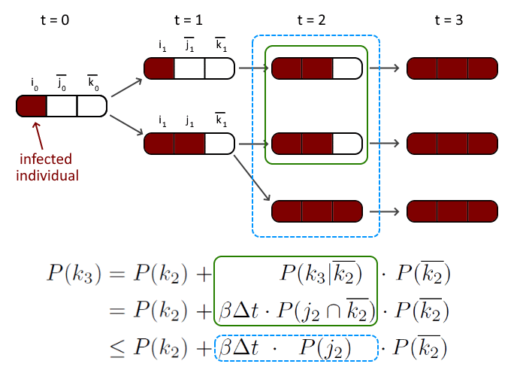
Fig. 8: Simplifications in the model (correlations between neighbors are not respected) lead to both a larger and faster epidemic outbreak compared to a Monte Carlo simulation. The example shown here is a chain of three people with the first one being infected. Blue (dashed) line: assumptions used in the model. Green (solid) line: actual expected behaviour, which corresponds to a Monte Carlo simulation.
Extra Slides

Slide 28
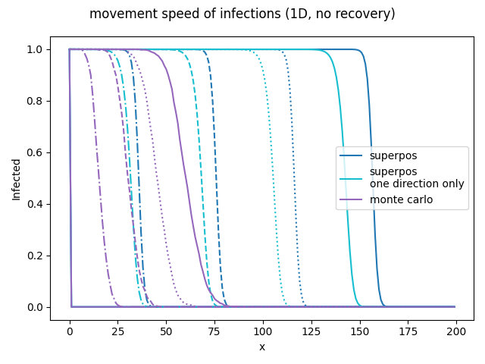
Fig. 9: Movement speed for a 1D chain of people. At t = 0 only the individual at x = 0 is infected. The figure shows the infected people at different time stamps (t = 250, 500, 750, 1000) with linestyles: (mixed, dashed, dotted, solid). Blue: Our model. Cyan: A restricted model where infections can only travel from left to right. Purple: A Monte Carlo Simulation with 1000 passes. β = 0.06, γ = 0. It can be seen that our model leads to a much faster spread than the Monte Carlo Method.
Extra Slides
Notes:
Awareness plot

Slide 29
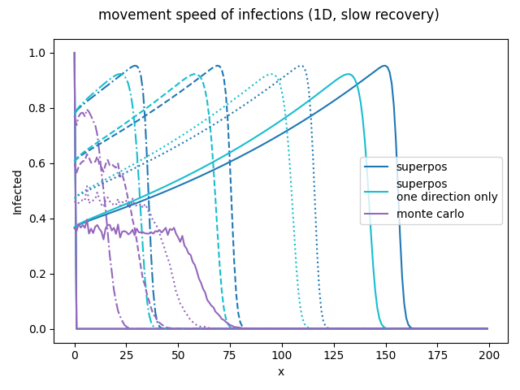
Fig. 10: Movement speed for a 1D chain of people. At t = 0 only the individual at x = 0 is infected. The figure shows the infected people at different time stamps (t = 250, 500, 750, 1000) with linestyles: (mixed, dashed, dotted, solid). Blue: Our model. Cyan: A restricted model where infections can only travel from left to right. Purple: A Monte Carlo Simulation with 1000 passes. β = 0.06, γ = 0.001. It can be seen that our model leads to a much faster spread than the Monte Carlo Method. The recovery does not limit the speed of the spread but it can heavily reduce the reach of the spread as there is always a chance of the infection not being passed on.
Extra Slides
Notes:
Awareness plot

Slide 30
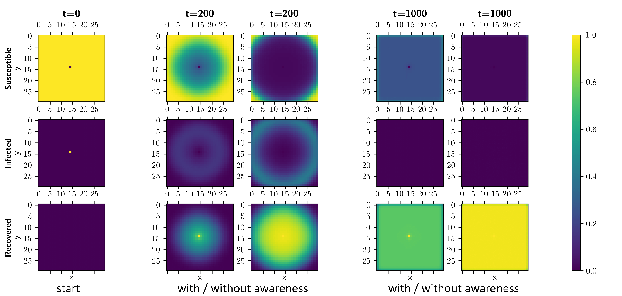
Fig. 11: Comparison for an outbreak with and without awareness.
Extra Slides
Notes:
Awareness plot

Slide 31
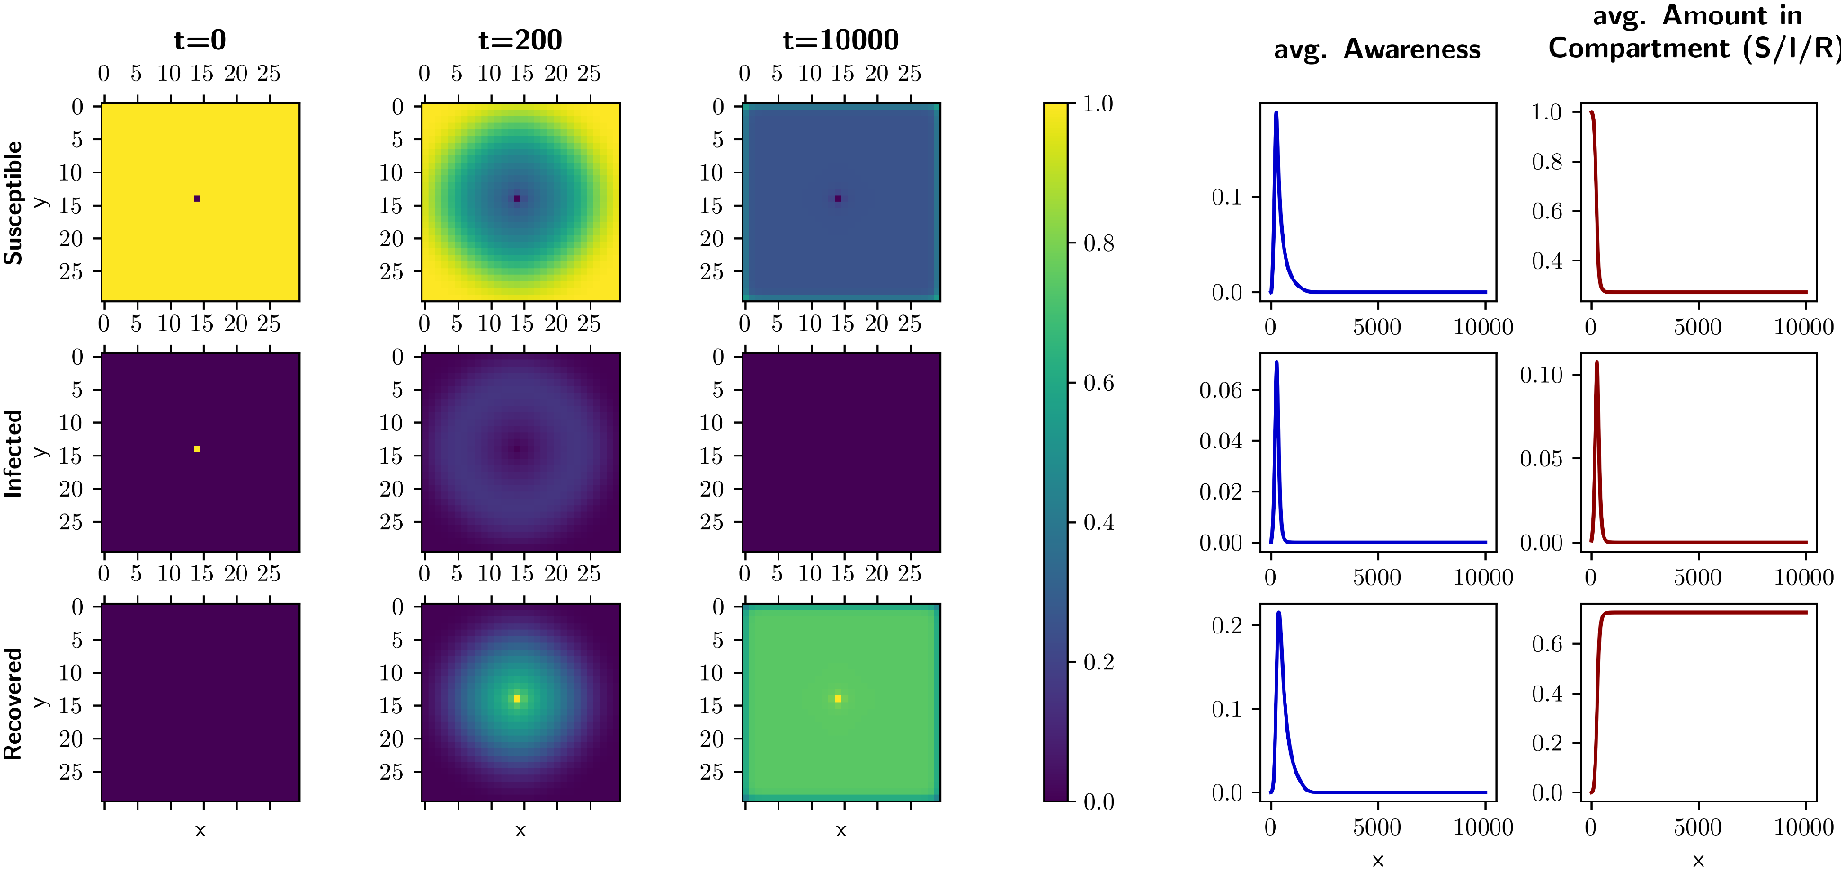
Fig. 12: The outbreak is contained even though the awareness has faded if the number of recovered people is above the threshold of 1 - 1/R₀ (= 75 % in this example).
Extra Slides
Notes:
Awareness plot

Slide 32
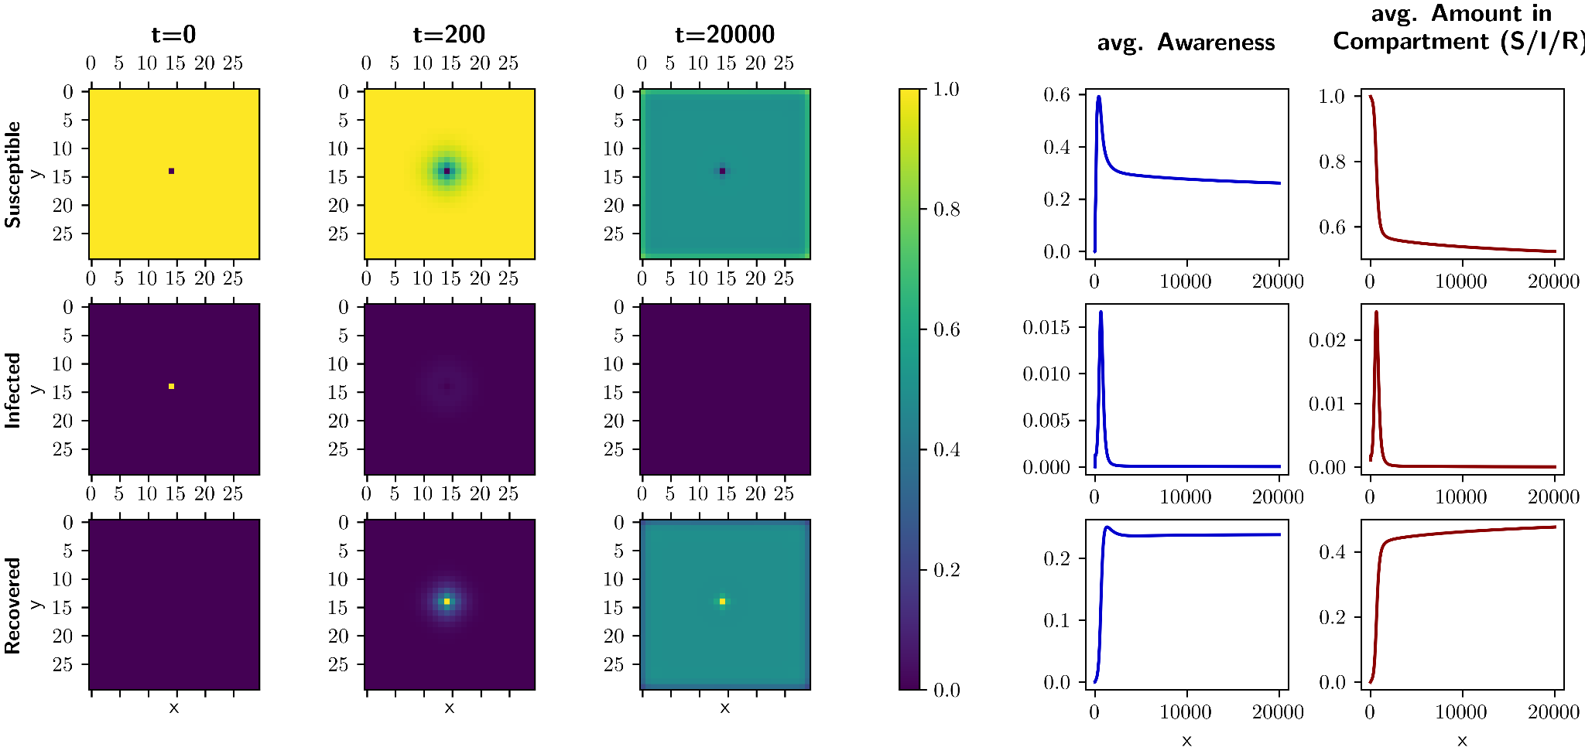
Fig. 13: The outbreak is contained for a long time by awareness present in the susceptible population even if the the threshold of 1 - 1/R₀ recovered people (= 75 % in this example) has not been reached.
Extra Slides
Notes:
Awareness plot

Slide 33
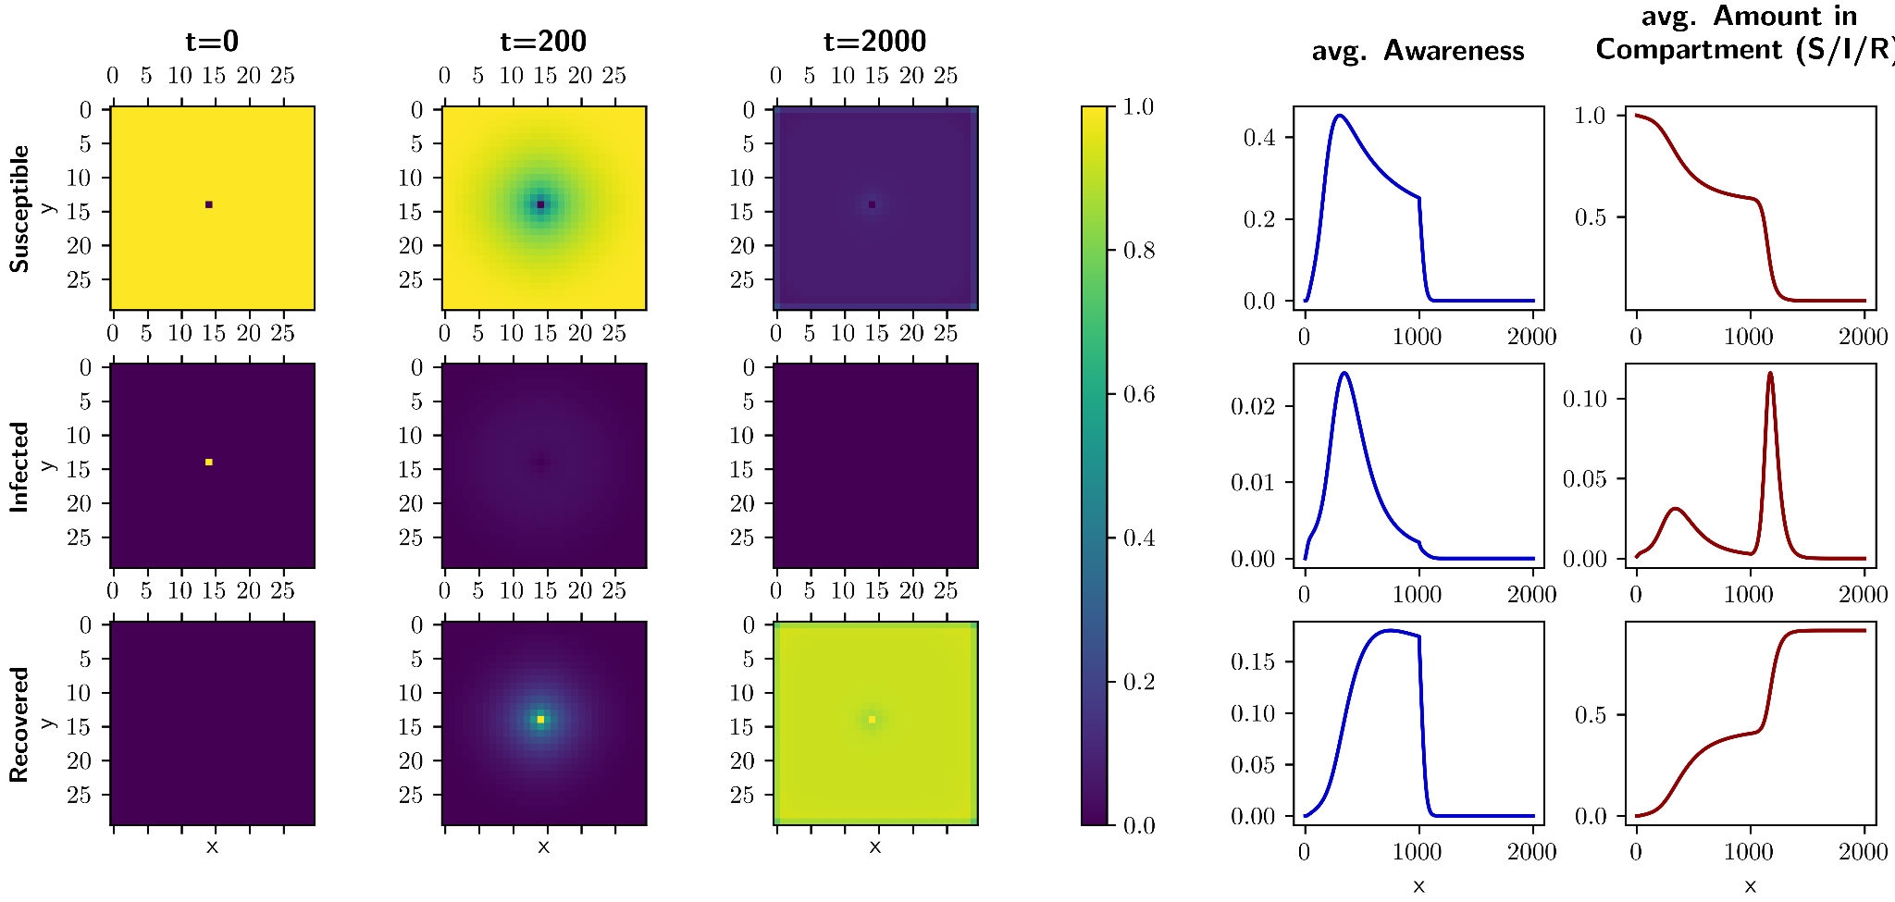
Fig. 14: If the awareness suddenly drops, a second wave is possible if the the threshold of 1 - 1/R₀ recovered people (= 75 % in this example) has not been reached.
Extra Slides
Notes:
Awareness plot

Slide 34
Default Parameters:
β: 0.03 normal infection rate
γ: 0.03 Recovery rate
ω: 0.06 Information generation rate
α: 0.06 Information transmission rate
λ: 0.05 Information fading rate
ϱ: 0.6 decay rate for information quality
κ: 0.7 self isolation probability
Extra Slides
Notes:
Awareness plot

Slide 35
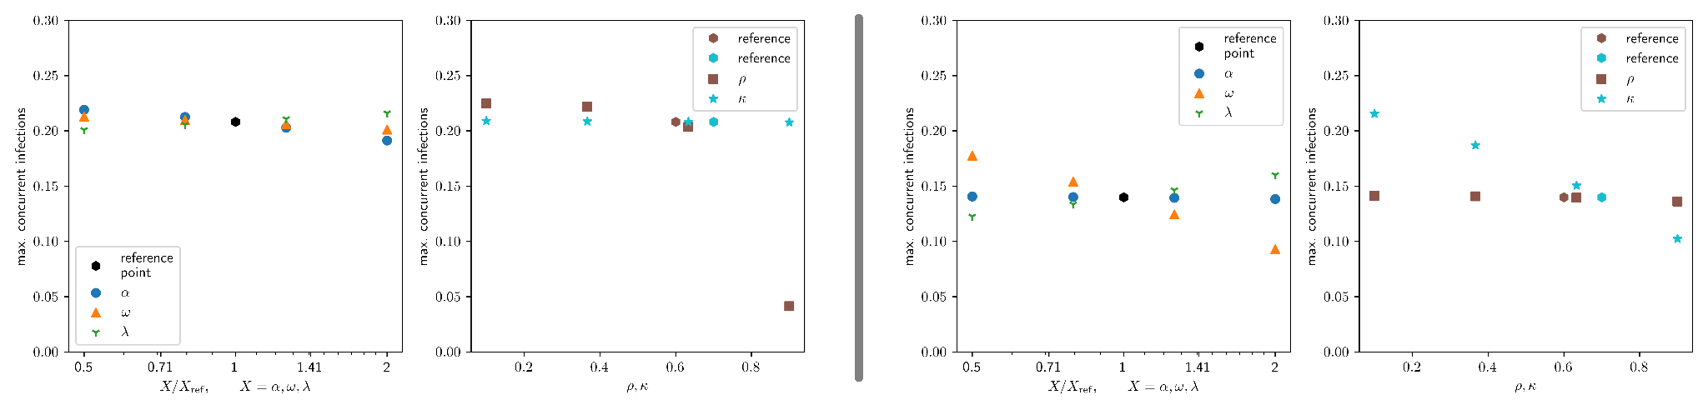
α: 0.1 Information transmission rate
ω: 0.001 Information generation rate
α: 0.001 Information transmission rate
ω: 0.1 Information generation rate
Parameters:
β: 0.03 normal infection rate
γ: 0.03 Recovery rate
ω: Information generation rate
α: Information transmission rate
λ: 0.05 Information fading rate
ϱ: 0.6 decay rate for information quality
κ: 0.7 self isolation probability
Fig. 15: Comparison of the sensitivity analysis done with respect to different reference points.
Left: Here the spread is dominated by a fast transmission of information while the information is generated at a slow rate. Therefore self isolation only has a little impact as the spreading of the virus is much faster than the virus is being detected.
Right: Here the transmission of information is very slow but the detection rate for generating new information is large, which leads to self isolation having a much greater impact in this scenario.
Extra Slides
Notes:
Awareness plot

Slide 36
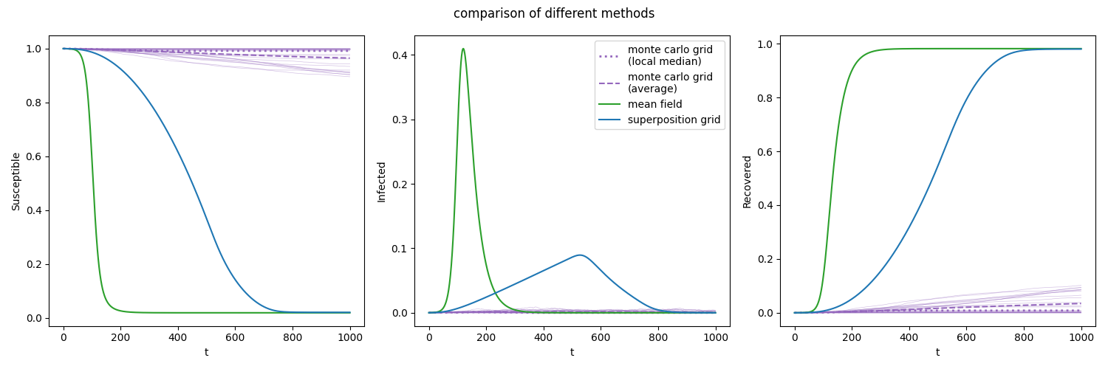
Fig. 16: Comparison between mean field approach (green), our model (blue) and a Monte Carlo simulation (purple) on a square lattice with size 100x100 for an SIR model (no information/awareness). β = 0.03, γ = 0.03. Our model leads to a linear increase in active cases because of the circular pattern moving outwards. The Monte Carlo simulation (25 passes) leads to a slower spread as the correlations between neighbours are not respected in our model. Here, the Monte Carlo simulation has the possibility to freeze out at low numbers and thus significantly reduces the total number of infections.
Extra Slides
Notes:
Awareness plot

Slide 37
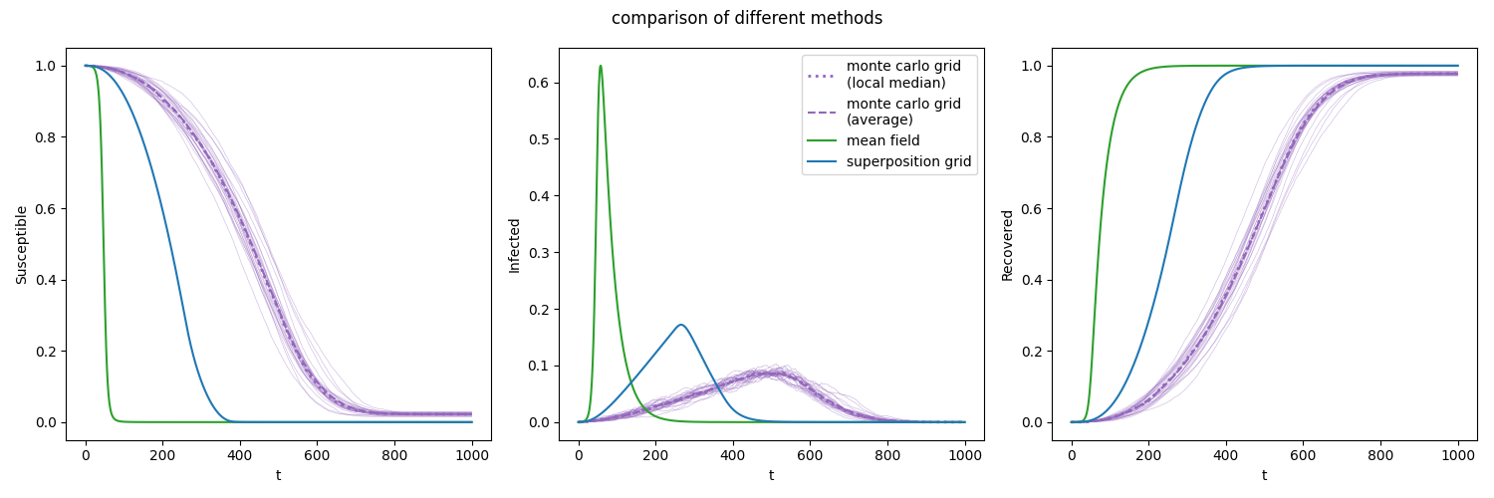
Fig. 17: Comparison between mean field approach (green), our model (blue) and a Monte Carlo simulation (purple) on a square lattice with size 100x100 for an SIR model (no information/awareness). β = 0.06, γ = 0.03. Our model leads to a linear increase in active cases because of the circular pattern moving outwards. The Monte Carlo simulation (25 passes) leads to a slower spread as the correlations between neighbours are not respected in our model.
Extra Slides
Notes:
Awareness plot

Slide 38
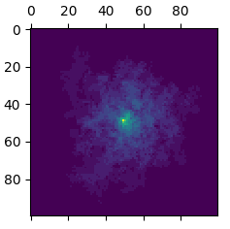
Fig. 18: Overlay of 25 Monte Carlo simulation on a square grid for = 0.03, γ = 0.03 at t = 1000, SIR only.
Extra Slides
Notes:
Awareness plot

Slide 39
Extra Slides
Notes:
Awareness plot

